Slide 1
MaxCounters
Calculate the values of counters after applying all alternating operations: increase counter by 1; set value of all counters to current maximum.

Slide 2
Problem
You are given N counters, initially set to 0, and you have two possible operations on them:
increase(X) − counter X is increased by 1,
max counter − all counters are set to the maximum value of any counter.
A non-empty array A of M integers is given. This array represents consecutive operations:
if A[K] = X, such that 1 ≤ X ≤ N, then operation K is increase(X),
if A[K] = N + 1 then operation K is max counter.
For example, given integer N = 5 and array A such that:
A[0] = 3, A[1] = 4, A[2] = 4, A[3] = 6, A[4] = 1, A[5] = 4, A[6] = 4
the values of the counters after each consecutive operation will be:
(0, 0, 1, 0, 0)
(0, 0, 1, 1, 0)
(0, 0, 1, 2, 0)
(2, 2, 2, 2, 2)
(3, 2, 2, 2, 2)
(3, 2, 2, 3, 2)
(3, 2, 2, 4, 2)
The goal is to calculate the value of every counter after all operations.
Write a function:
def solution(N, A)
that, given an integer N and a non-empty array A consisting of M integers, returns a sequence of integers representing the values of the counters.
Result array should be returned as an array of integers.
For example, given:
A[0] = 3, A[1] = 4, A[2] = 4, A[3] = 6, A[4] = 1, A[5] = 4, A[6] = 4
the function should return [3, 2, 2, 4, 2], as explained above.
Write an efficient algorithm for the following assumptions:
N and M are integers within the range [1..100,000];
each element of array A is an integer within the range [1..N + 1].

Slide 3
Example
For example, given integer N = 5 and array A such that:
A[0] = 3, A[1] = 4, A[2] = 4, A[3] = 6, A[4] = 1, A[5] = 4, A[6] = 4
the values of the counters after each consecutive operation will be:
(0, 0, 1, 0, 0)
(0, 0, 1, 1, 0)
(0, 0, 1, 2, 0)
(2, 2, 2, 2, 2)
(3, 2, 2, 2, 2)
(3, 2, 2, 3, 2)
(3, 2, 2, 4, 2)
The goal is to calculate the value of every counter after all operations.
If given:
A[0] = 3, A[1] = 4, A[2] = 4, A[3] = 6, A[4] = 1, A[5] = 4, A[6] = 4
the function should return [3, 2, 2, 4, 2] as explained.

Slide 4
Hint: Let’s analyze the Brute-Force Solution
In Brute-Force solution, we follow the instructions as given.
We increase the counters on encountering the increase operation.
And on encountering the maxCounter() operation, we loop over the counters and set them equal to max counter.
This would solve the problem but would result in a quadratic time complexity.

Slide 5
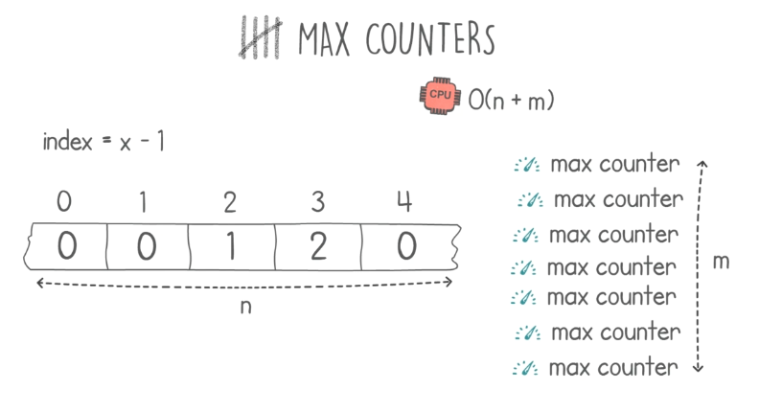
Hint: Worst Case Scenario For Brute Force Solution.
Time Complexity of: N*M

Slide 6
Hint: Linear Time Complexity
The bottleneck for the code is the maxCounter() operation.
So, in this solution we find a smart way of implementing the maxCounter() operation.
We would draw an analogy between our counters and racers on a race track.
We would maintain two variables:
1. startLine: that tracks the where the racers are starting.
Basically, on encountering the maxCounter() operation, we would update this field.
2. currentMax: That tracks the maximum value among the counters.
This variable will be used to update the other variable startLine on encountering a maxCounter() operation.

Slide 7
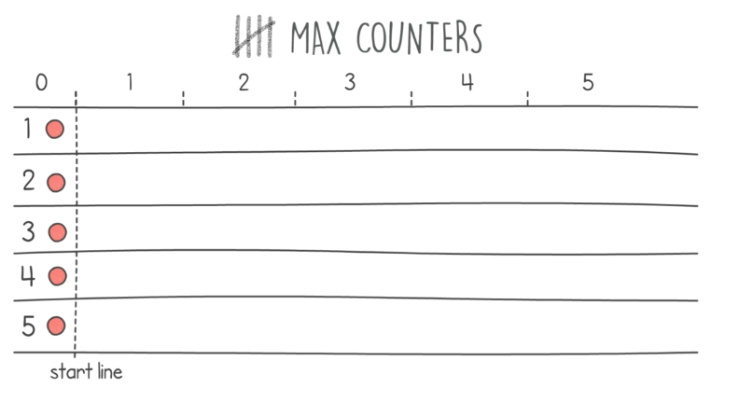
Hint: Linear Time Solution

Slide 8
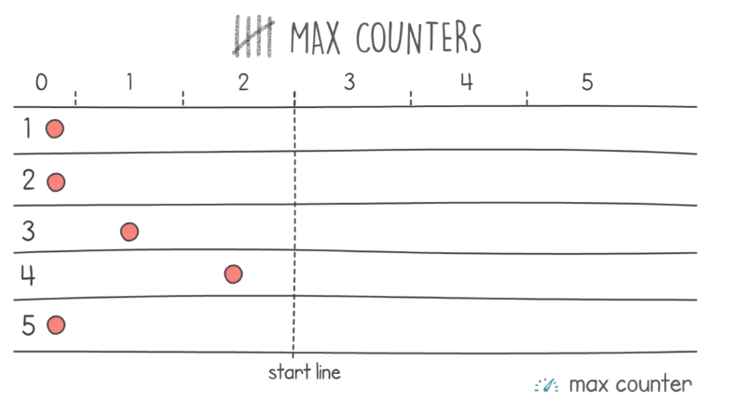
Hint: What happens when we encounter a maxCounter() op? We update our startLine.

Slide 9
Code
def increase(X, counters, startLine, currentMax):
if counters[X] < startLine:
counters[X] = startLine
counters[X] += 1
if counters[X] > currentMax:
currentMax = counters[X]
return counters, currentMax
def maxCounter(startLine, currentMax):
startLine = currentMax
return startLine
def solution(N, A):
startLine = 0
currentMax = 0
counters = [0 for i in range(N)]
for i in A:
if i < N+1:
counters, currentMax = increase(i-1, counters, startLine, currentMax)
else:
startLine = maxCounter(startLine, currentMax)
for i in range(len(counters)):
if counters[i] < startLine:
counters[i] = startLine
return counters

Slide 10
Detected time complexity: O(N + M)

Slide 11
Test Cases
Correctness tests
extreme_small
all max_counter operations
single
only one counter
small_random1
small random test, 6 max_counter operations
small_random2
small random test, 10 max_counter operations
Performance tests
medium_random1
medium random test, 50 max_counter operations
medium_random2
medium random test, 500 max_counter operations
large_random1
large random test, 2120 max_counter operations
large_random2
large random test, 10000 max_counter operations
extreme_large
all max_counter operations

